Slide 1
Class of 2023-24

Slide 2
Your PA journey starts here!
Achieve or exceed your MEG in every subject!
Year 11
Challenge yourself – be better than last week, term, year
Year 10
Use strong foundations to choose your options
Year 9
Embed knowledge and make good progress
Year 8
Settle in, make friends and be your best self.
Year 7
Notes:
Set scene for high achievement and lead into next slide, introducing the tutors who will help them reach their goals.

Slide 3
Parent Information
Year group ethos and focus
Homework expectations, support and intervention
Praise and sanction processes
Issue parent logins for class charts and instructions on how to set this up
Standardised testing
Bude update
Key dates for your diary
Tutor Q/A and contacts update
Notes:
Read through the bullet points and explain how they will achieve this today

Slide 4
Ethos and focus
Sensational - very good indeed; very impressive
How will your child be sensational this year?
Notes:
Set scene for high achievement and lead into next slide, introducing the tutors who will help them reach their goals.

Slide 5
Homework
We believe the purpose of homework should be to retrieve, practice, reinforce, or apply acquired skills and knowledge.
We also believe, as research supports, that moderate assignments completed and done well are more effective than lengthy or difficult ones done poorly.
Notes:
Set scene for high achievement and lead into next slide, introducing the tutors who will help them reach their goals.

Slide 6
Homework
Retrieval task – recall of knowledge
20 minutes to complete (approximately)
Set by class teacher – tracked by class teacher
Notes:
Set scene for high achievement and lead into next slide, introducing the tutors who will help them reach their goals.

Slide 7
Homework
Homework serves to develop:
regular study skills
good habits
the ability to complete assignments independently.
Completing homework is the responsibility of the student, and as students mature they are able to work more independently.
As parents, you play a supportive role in:
monitoring completion of assignments,
encouraging students’ efforts
providing a conducive environment for learning.
Notes:
Set scene for high achievement and lead into next slide, introducing the tutors who will help them reach their goals.

Slide 8
Homework
If homework is not completed:
Stage 1: Homework intervention – catch up club, LRC, deadline extension, phone call home,
Stage 2: Conduct Detention – 1 hour – homework completed in detention
Homework starts next week.
Notes:
Set scene for high achievement and lead into next slide, introducing the tutors who will help them reach their goals.

Slide 9
Praise – Conduct Cards
What is a conduct card?
A strategy to uphold behaviour expectations and promote positive behaviour
To record positive behaviours
Conduct cards collected and given out on Friday – Plympton Positive and Clean Conduct Card points added by tutor on Class Charts
Notes:
Set scene for high achievement and lead into next slide, introducing the tutors who will help them reach their goals.

Slide 10
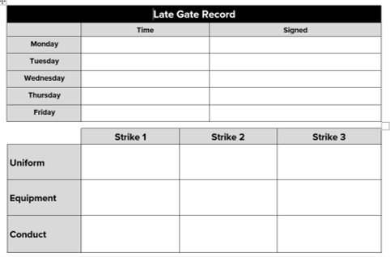
Sanctions – Conduct Cards
What is a conduct card?
A strategy to uphold behaviour expectations and promote positive behaviour
To record negative behaviours
Notes:
Set scene for high achievement and lead into next slide, introducing the tutors who will help them reach their goals.

Slide 11
Sanctions – Conduct Cards
Staff will strike a conduct card if a student is not meeting the Academy's behaviour expectations for uniform, equipment or conduct in and out of lessons
Three strikes – staff member issuing third strike takes conduct card and puts on detention CC with comment to support parent conversations at home.
Example comment (1st strike for pushing in corridor, 2nd strike for having not having a green pen and 3rd strike for wearing a hoodie)
Notes:
Set scene for high achievement and lead into next slide, introducing the tutors who will help them reach their goals.

Slide 12
Be Your Best Self
Praise
Your child will be rewarded for:
Term 1 habits of learning focus.
Notes:
Set scene for high achievement and lead into next slide, introducing the tutors who will help them reach their goals.

Slide 13
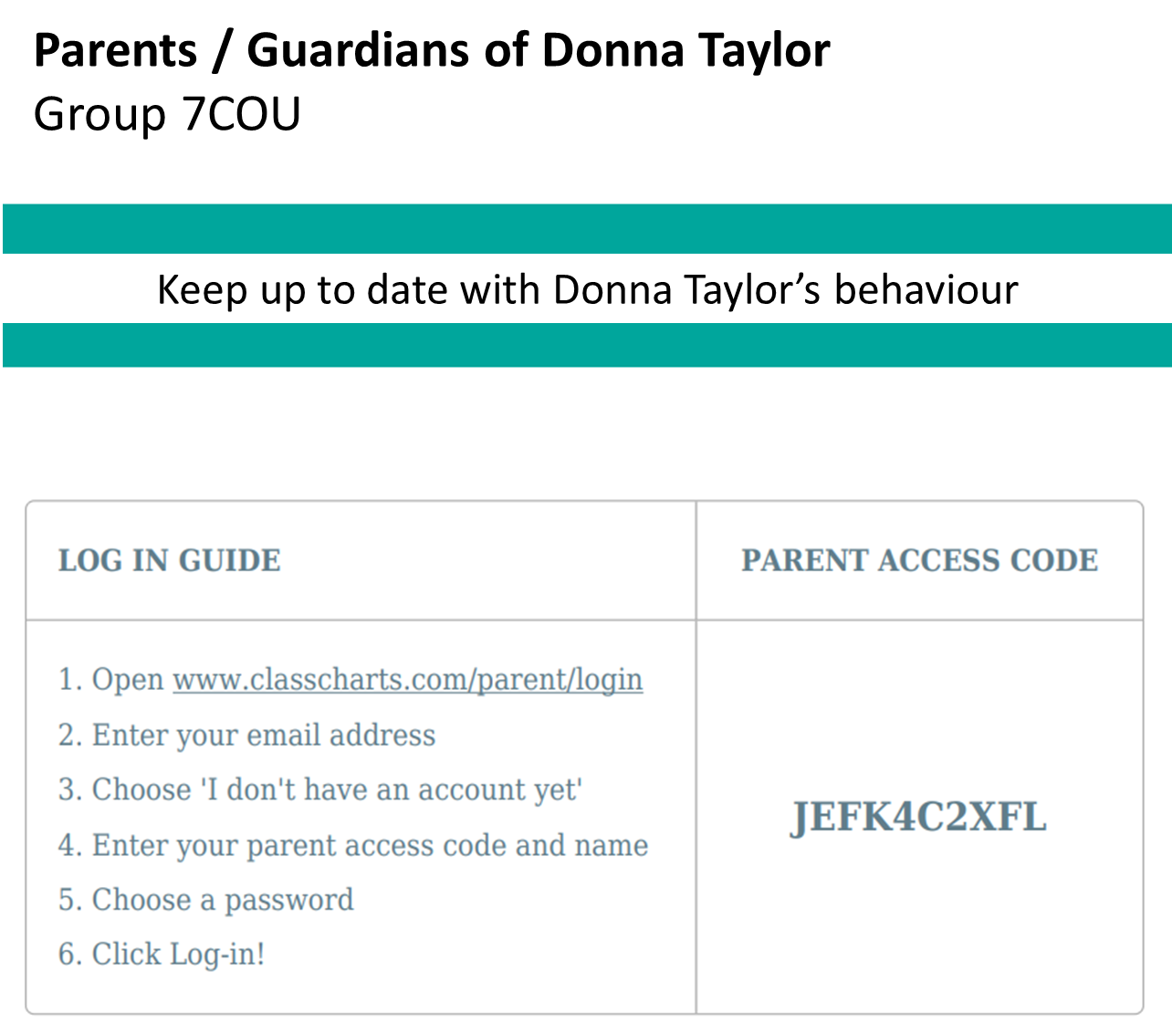
Class charts Codes
You will be given your code today.
Follow the instructions in the log in guide and follow your child’s behaviour progress.

Slide 14
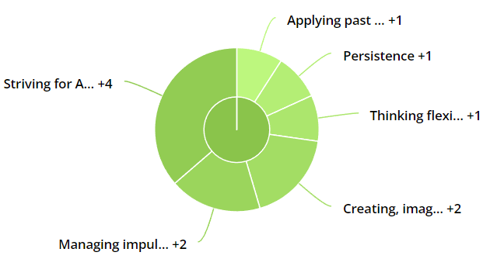
Class charts

Slide 15
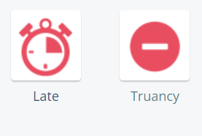
Be Your Best Self
Sanctions
Your child will be sanctioned for:
Notes:
Set scene for high achievement and lead into next slide, introducing the tutors who will help them reach their goals.

Slide 16
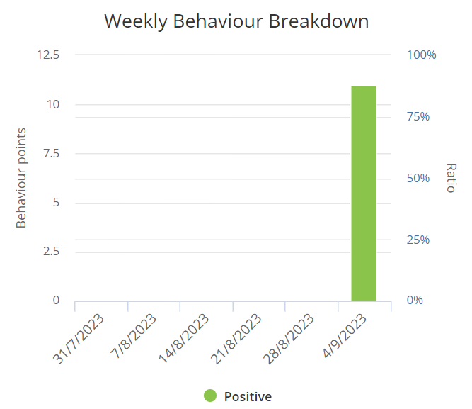
Class charts

Slide 17
Be Your Best Self
Sanctions
Your child will be sanctioned for:
Notes:
Set scene for high achievement and lead into next slide, introducing the tutors who will help them reach their goals.

Slide 18
Internal Reflection
Internal Reflection
Attend for 5 periods from the lesson that the sanction was given
Leave school at 3:15
Reflect on behaviour that led to the sanction
Complete work in line with the curriculum
Restorative conversation with member of staff and contact home
Notes:
Set scene for high achievement and lead into next slide, introducing the tutors who will help them reach their goals.

Slide 19
Detentions
Conduct Detentions
1 hour conduct detention
Late to school
Repeated lateness to lessons
Missed homework intervention
Repeated kit fault in PE/Dance (3 in a half term)
1 hour conduct card detentions
Refusal to handover
Not having a conduct card
Threes strike on a conduct card
1 hour truancy detention
If detentions are missed it will lead to Internal Reflection the next day and student will still need to sit the detention
Information provided by member of staff on Class Charts
Notes:
Set scene for high achievement and lead into next slide, introducing the tutors who will help them reach their goals.

Slide 20
Standardised testing
To support KS2 data and ensure your child is in the most suitable teaching group to make good progress we carry out standardised testing at the beginning of the year.
These tests are not like SATs.
Children do not need to revise or prepare for them
Conducted during lessons, over a number of weeks to minimise disruption to learning
Notes:
Set scene for high achievement and lead into next slide, introducing the tutors who will help them reach their goals.

Slide 21
Standardised testing
CAT4 (45 mins) will be completed over the next two weeks
PASS test (20 mins) tagged on to one of the papers.
Progress Tests for Science, Maths and English (1 hour) will be undertaken in one of those subject lessons by October half term.
Notes:
Set scene for high achievement and lead into next slide, introducing the tutors who will help them reach their goals.

Slide 22
Standardised testing
Please ask if your child would like to bring their own set of wired headphones to use in the CATs next week as headphones are required.
We do have a number of head sets and ear buds for them but they might be more comfortable using their own WIRED headset!
Notes:
Set scene for high achievement and lead into next slide, introducing the tutors who will help them reach their goals.

Slide 23
Book work
Notes:
Set scene for high achievement and lead into next slide, introducing the tutors who will help them reach their goals.

Slide 24
Bude
Monday 30th Oct - Wednesday 1st November 2023.
Information letter will be sent home at the start of next week
Day trip on Tuesday 31st October. The cost for this trip will be £55
Both trips open on ParentPay for payments to secure places
http://www.adventure.uk.com/downloads/AdventureBude-ParentsInformation.pdf
Notes:
Talk them through class charts and the rewards we have.

Slide 25
Uniform expectations
Uniform:
Blazer on
Shirt tucked in
Black shoes
Tie - 5 stripes!
The following are not allowed​
Leggings, jeans etc.​
Nose studs​
Any other jewellery e.g. bracelets, anklets​
False eyelashes​
False nails​
Nail polish​
Earrings that are not plain studs. ​
​Students in years 7/8 ​
No make up​
Parents – please email your child’s tutor if you still have uniform queries.

Slide 26
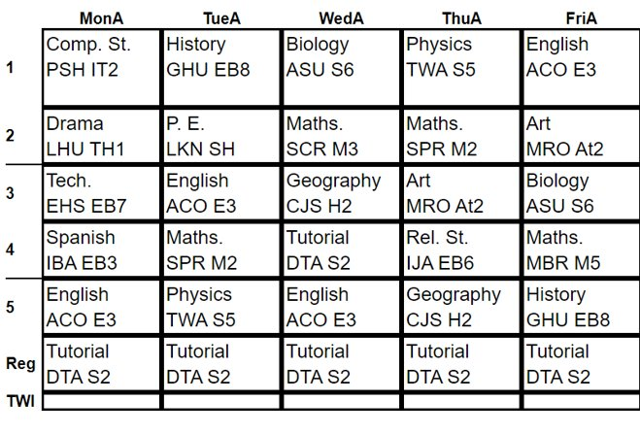
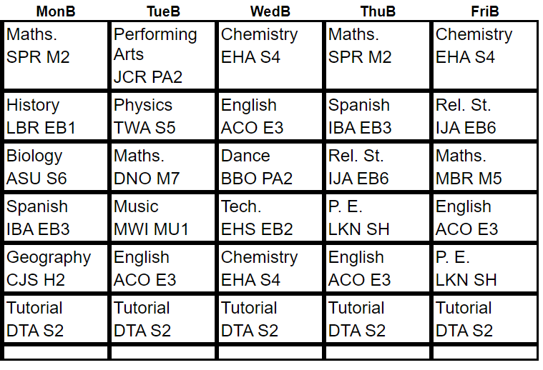
Timetables
This is an example timetable
It has a two-week format; week A and week B
This week is Week A.
Each day is the vertical column showing your lessons 1 to 5.
Break is between lesson 2 and 3 – in the canteen
Lunch I between lesson 4 and 5 – in the canteen
Each box shows the subject code, room and teacher initials.

Slide 27
Dates for the Diary Term 1
Thursday 21st September – Academy Open Evening
Friday 22nd September – Late start 9.40am
w/c 9th October – Bude briefing – date TBC
Friday 20th October – Academy closed to students – TSAT CDP day
Monday 23rd – Friday 27th October - Half term
Monday 30th – Wednesday 1st November - Bude
Notes:
Set scene for high achievement and lead into next slide, introducing the tutors who will help them reach their goals.

